Slide 1
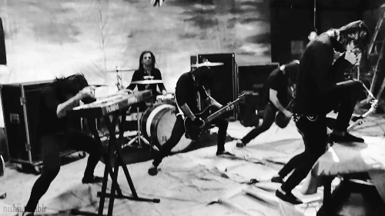
Automated Music Genre Classification with Deep Learning Techniques
Presenters: Misha Seroukhov || Dhanyapriya Somasundaram

Slide 2
Why Bother?
Audio analysis is larger field includes music classification, Automatic speech recognition, Digital Signal processing etc
Not every company should rely on external APIs from Shazam and Spotify, and should instead have a readily-available solution
Applications: Siri, Google Home, Alexa

Slide 3
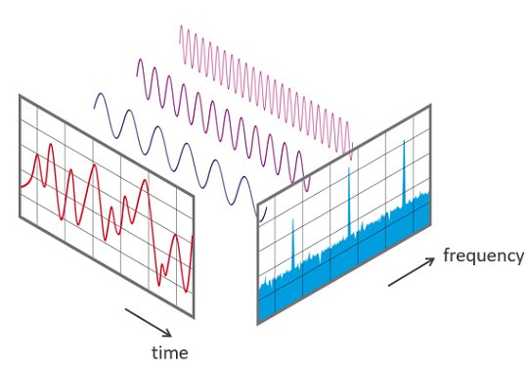
How do we Handle Audio data??
Sound is represented in the form of an audio signal having parameters such as frequency, bandwidth, decibel

Slide 4
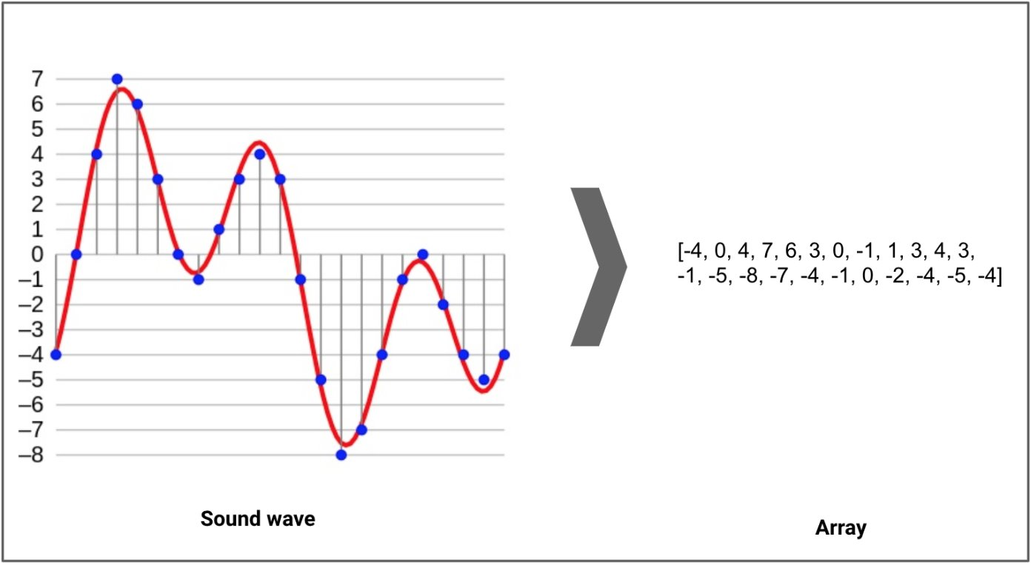
Sampling
Digitizing the Sound waves
Sampling Rate
The number of samples of audio recorded every second, measured in Hz.​​​
Higher rates capture more detail but require more data.​​​
​​Standard Rates: 44.1kHz.​​

Slide 5
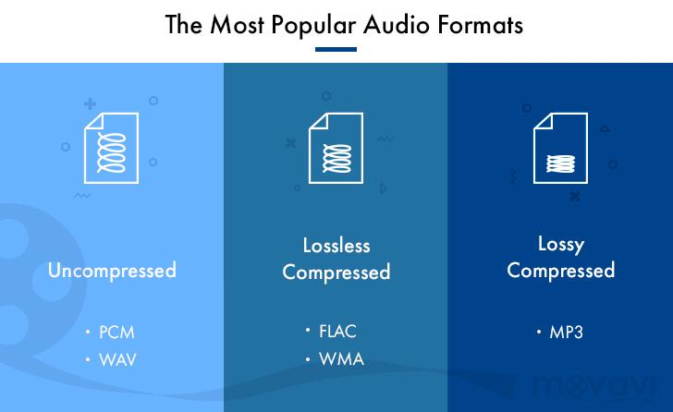

Slide 6
Audio File Processing with Python
Used Google Colab
Used Librosa, Numpy, Pandas, and Sklearn to process data
Used TensorFlow and Keras to construct model
Used Matplotlib, Seaborn, and Visualkeras to visualize data
Used Jetstream2 GPU for the model training

Slide 7
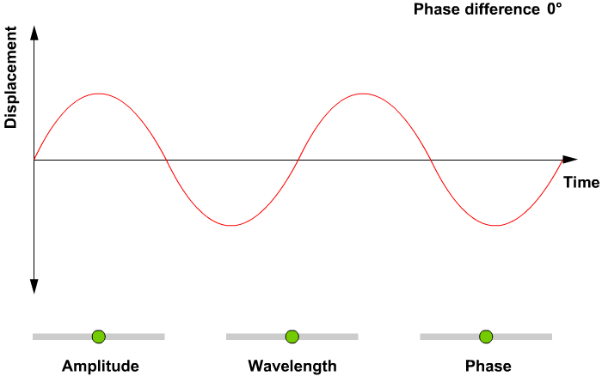
VISUALISE THE AUDIO--waveplots

Slide 8
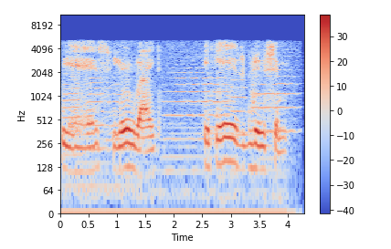
VISUALISE THE AUDIO--Spectrogram

Slide 9
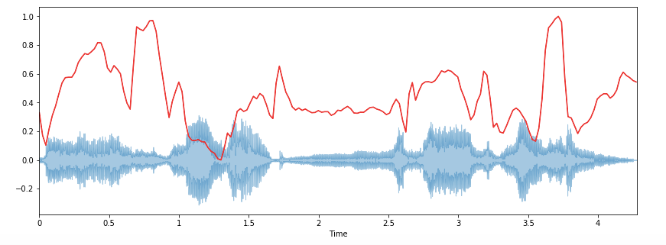
Feature Extraction from Audio Signals
Spectral Centroid--

Slide 10
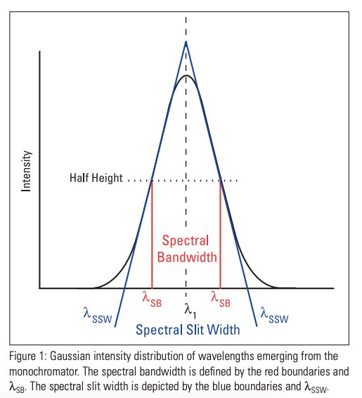
Feature Extraction from Audio Signals​
Spectral Bandwidth-- ​​

Slide 11
Feature Extraction from Audio Signals​
Mel-Frequency Cepstral Coefficients(MFCCs)
MFCCs of a signal are a small set of features (usually about 10–20) which concisely describe the overall shape of a spectral envelope.
It models the characteristics of the human voice.

Slide 12
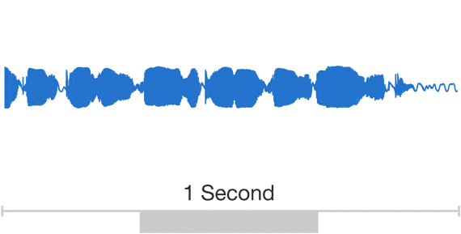
Music Genre Classification Using ANN

Slide 13
RESEARCH PAPERS
G. Tzanetakis and P. Cook, "Musical genre classification of audio signals," in IEEE Transactions on Speech and Audio Processing, vol. 10, no. 5, pp. 293-302, July 2002, doi: 10.1109/TSA.2002.800560. keywords: {Humans;Music information retrieval;Instruments;Computer science;Multiple signal classification;Signal analysis;Pattern recognition;Feature extraction;Wavelet analysis;Cultural differences},
K. Zaman, M. Sah, C. Direkoglu and M. Unoki, "A Survey of Audio Classification Using Deep Learning," in IEEE Access, vol. 11, pp. 106620-106649, 2023, doi: 10.1109/ACCESS.2023.3318015. keywords: {Deep learning;Hidden Markov models;Data models;Feature extraction;Surveys;Task analysis;Speech recognition;Audio systems;Emotion recognition;Classification algorithms;Recurrent neural networks;Audio;speech;music;emotion;noise;classification;recognition;deep learning;CNNs;RNNs;autoencoders;transformers;hybrid models},
W. Zhu and M. Omar, "Multiscale Audio Spectrogram Transformer for Efficient Audio Classification," ICASSP 2023 - 2023 IEEE International Conference on Acoustics, Speech and Signal Processing (ICASSP), Rhodes Island, Greece, 2023, pp. 1-5, doi: 10.1109/ICASSP49357.2023.10096513. keywords: {Representation learning;Measurement;Time-frequency analysis;Semantics;Buildings;Training data;Data visualization;Audio event classification;audio Transformer;multiscale audio Transformer},
Lei Yang, Hongdong Zhao, "Sound Classification Based on Multihead Attention and Support Vector Machine", Mathematical Problems in Engineering, vol. 2021, Article ID 9937383, 11 pages, 2021. https://doi.org/10.1155/2021/9937383

Slide 14
Dataset
GTZAN Dataset from MARSYAS (Music Analysis, Retrieval and Synthesis for Audio Signals - https://marsyas.info/index.html)
10 class labels (genres) with 100 files of 30-second samples = 30,000 seconds
The dataset consists of 10 genres:
Blues
Classical
Country
Disco
Hiphop
Jazz
Metal
Pop
Reggae
Rock
Sample rate is 22,050 Hz (low-quality – standard is ~44 kHz)

Slide 15
CONVERTING THE AUDIO FILES

Slide 16
EXTRACTING THE SPECTROGRAMS

Slide 17
EXTRACTING THE FEATURES OF SPECTROGRAM

Slide 18
BUILD ANN MODEL

Slide 19
DENSE LAYERS, ReLU & Softmax A.F

Slide 20
Adam Optimisers

Slide 21
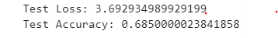
100 EPOCHS

Slide 22
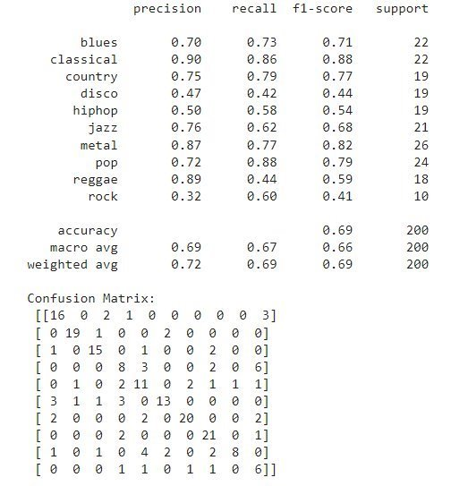
classification report
Model Performs well
Model Struggles
Model is conservative
High numbers-correct predictions

Slide 23
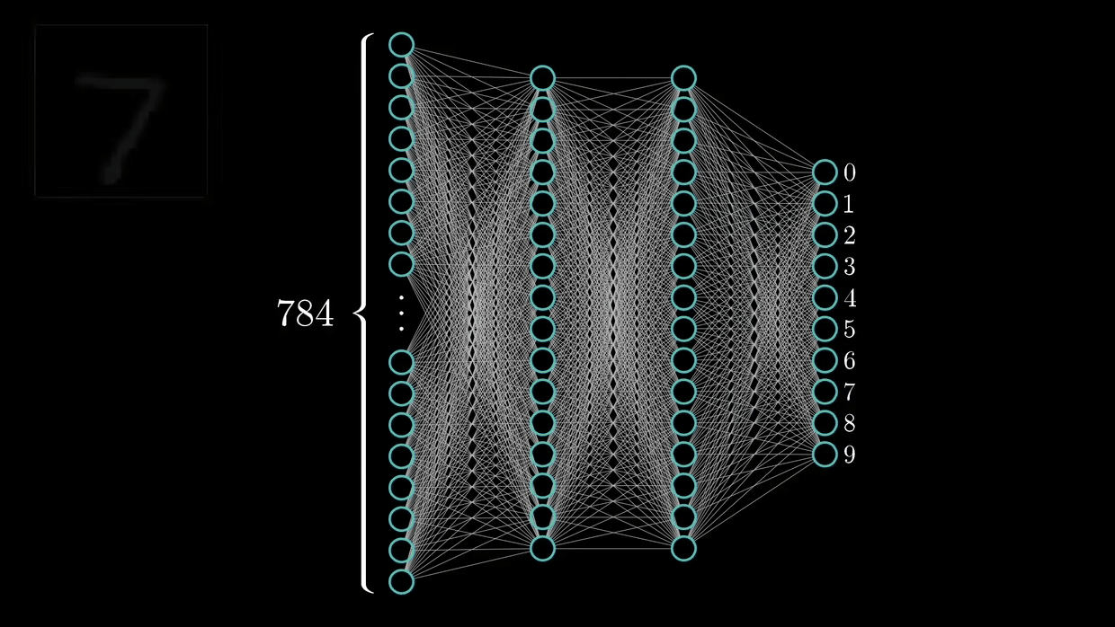
Music Genre Classification: Convolutional Neural Networks (CNN) ---Spectrogram

Slide 24
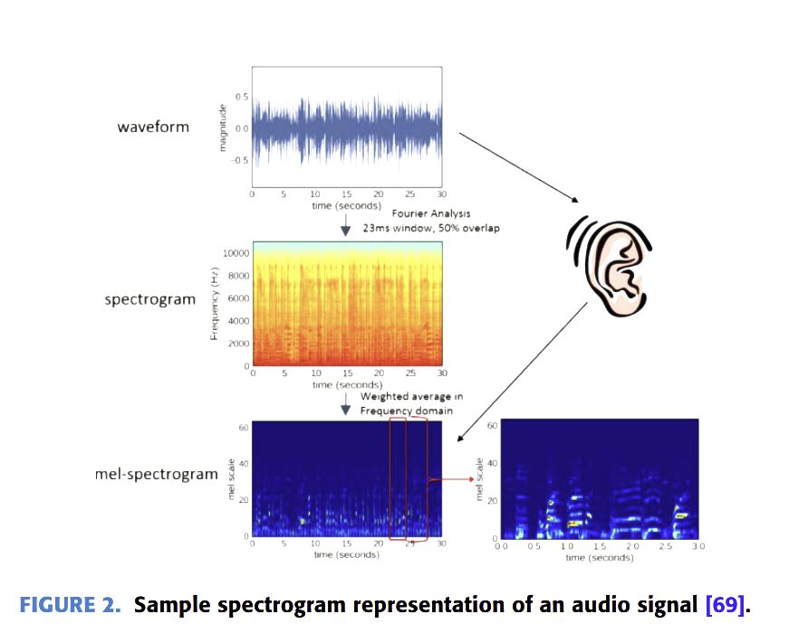

Slide 25
CONVERTING THE AUDIO FILES

Slide 26
EXTRACTING THE SPECTROGRAMS

Slide 27
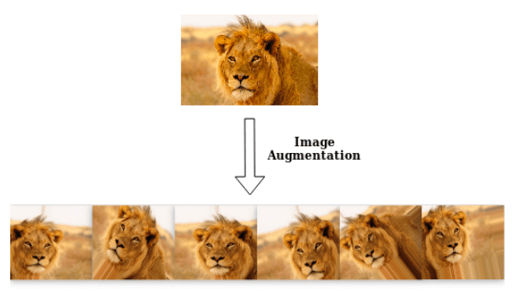
IMAGE AUGUMENTATION

Slide 28
CNN

Slide 29
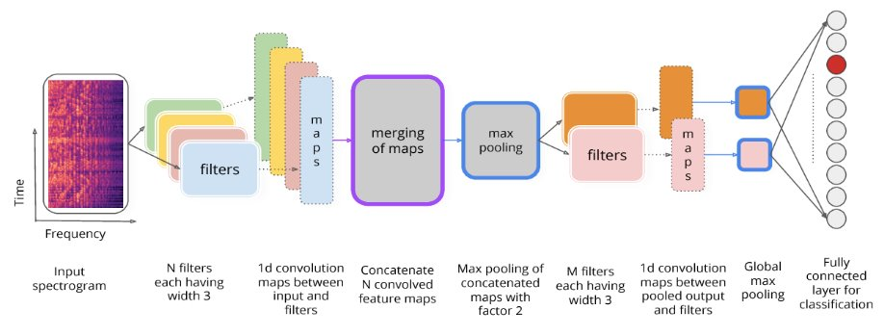

Slide 30
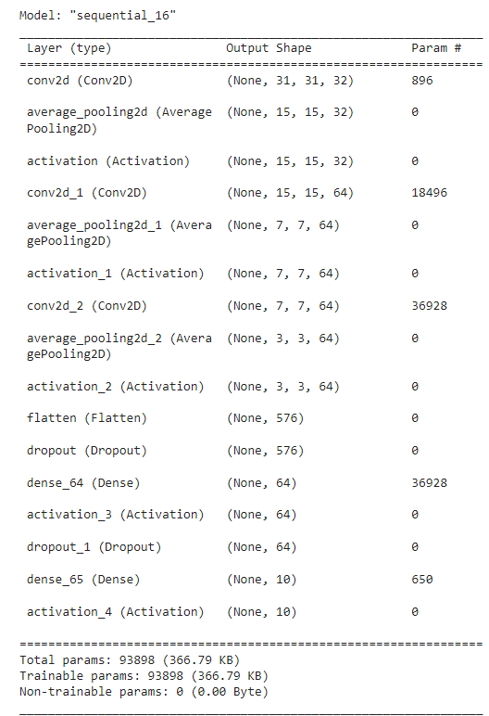

Slide 31
Compile/train the network using Stochastic Gradient Descent(SGD)

Slide 32
200 EPOCHS Test_Accuracy:37%

Slide 33
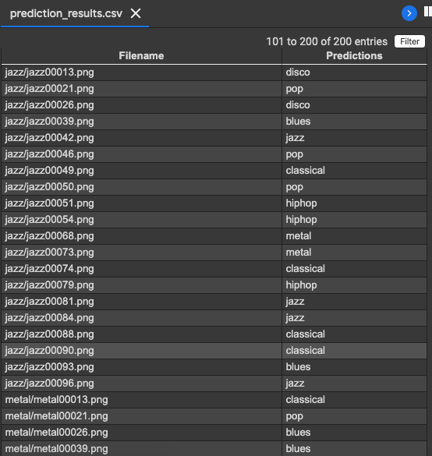

Slide 34
Music Genre Classification: CNN ---using MFCC

Slide 35
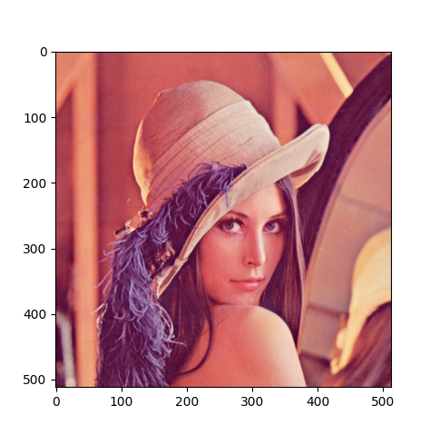
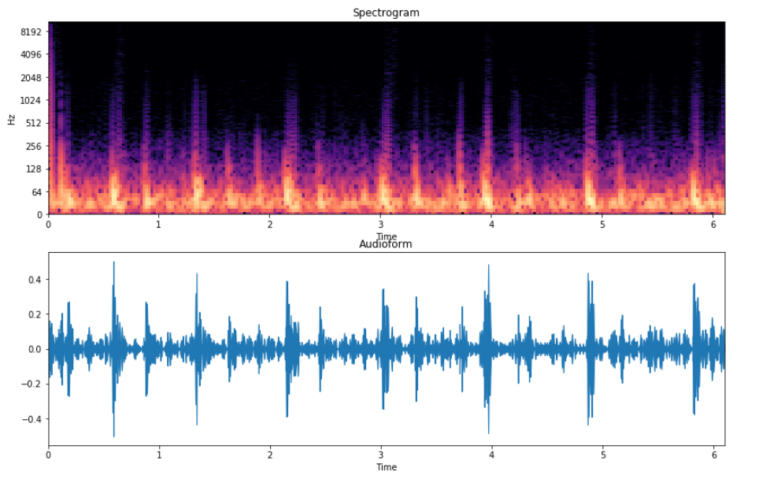
But Why CNN?
The frequency values of an audio file can be plotted over time to create a matrix like an image to create a spectrogram
(X, Y) 🡪 (sec, Hz)

Slide 36
Data Preprocessing
Need to slice each audio file into 30 slices to produce 30,000 data instances
For each slice sample, a Mel-frequency cepstrum coefficient (MFCC) is calculated across 20 frequency bands
An MFCC can be considered a “spectrum-of-spectrums” that mirrors how people perceive audio and music better than the linear data stored in the file
Engineered features were already provided in a CSV with the dataset, but we decided to process them ourselves for fine-tuning
Result: 2 GB of WAV audio files is aggregated into a 500 MB JSON feature matrix (661M samples reduced to 33M coefficients)

Slide 37
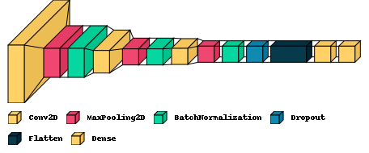
The CNN Model
Custom model with 3 sets of convolution, pooling, and normalizing, followed with dropout, flattening, and SoftMax activation for 10 class labels
Number of trainable parameters totals to 65,658 (256.48 KB)
This is relatively very small (AlexNet has 62M parameters)
Adam algorithm of SGD as optimizer, sparse cross-entropy loss function

Slide 38
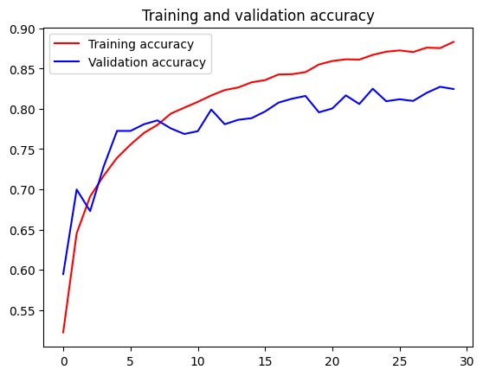
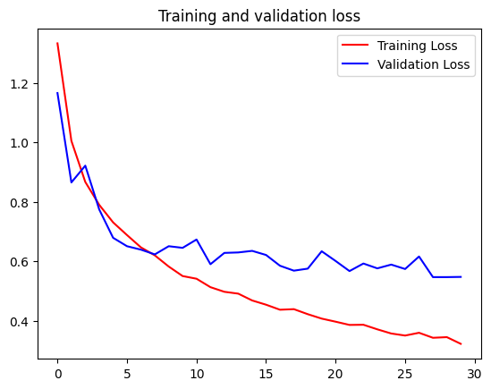
Training CNN
90-10 train-validation-test split (81% train, 10% validation, 9% test)
30 epochs took 34 minutes on CPU to reach accuracy of 88.33% and loss of 0.3233
Validation reached accuracy of 82.47% and loss of 0.5480

Slide 39
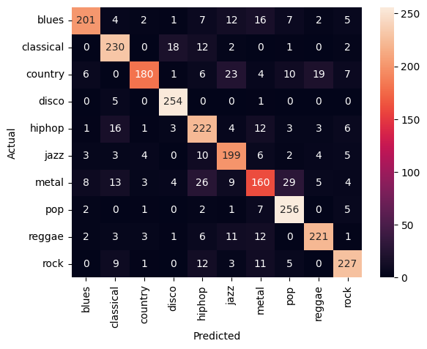
Testing CNN
Accuracy of 82.44%
Precision of 82.77%
Recall of 82.37%
F1-Score of 82.24%
Jazz and country were also observed to be worst-performing

Slide 40
What do you think?
Thank for listening!

